Slide 1
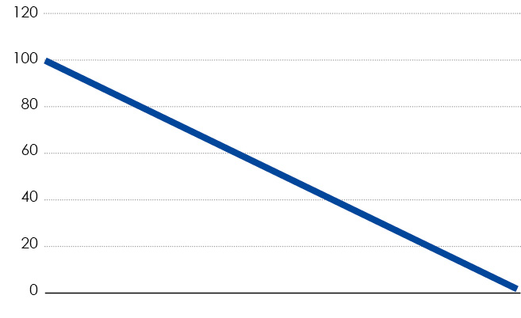
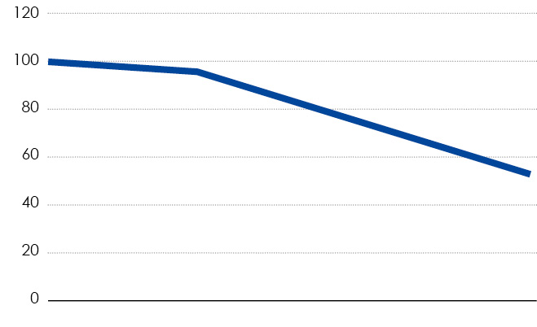
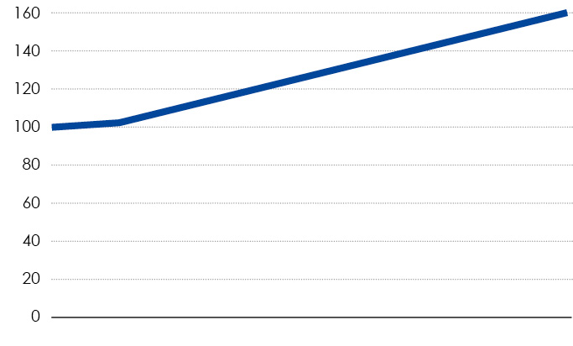
WoodsmartTM Optimizing Service
BENEFITS AND ADVANTAGES
Easy to get, no need for big investment proposal
Newest technology always available
Service includes changes in production process, for example change of wood material
Does not need resources from customer side, know-how always available
Continuous maintenance and modernization
Savings (for example less raw material loss, energy save, personnel resource) significantly bigger than service fee per month
Realtime production reports
Funding from Teknosavo.
PRODUCT INVESTMENT ONLY
PRODUCT INVESTMENT WITH MAINTENANCE
Technology gets old
Usability weakens
Lack of maintenance decreases accuracy
Technology gets old
Spare part purchasing becomes difficult
TOTAL OPTIMIZING SERVICE
Always newest technology
Continuous development

